Slide 1



Game
Studio
Game Design - 210
Prof. Alec McClure

Slide 2
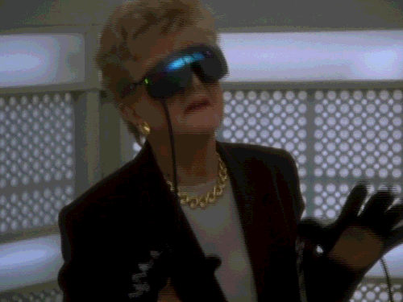
Evolving Interfaces && VR
“Where am I?”
Jessica Fletcher on the Oculus Rift Murder She Wrote

Slide 3
vir·tu·al ˈvərCH(əw)əl/ adjective
adjective: virtual
not physically existing as such but made by software to appear to do so. "a virtual computer"
synonyms: simulated, artificial, imitation, make-believe;

Slide 4
"Paradoxical logic [ the logic ruling digital media ] emerges when the real-time image dominates the thing represented, real time subsequently prevailing over real space, virtually dominating actuality and turning the concept of reality on its head."
-Paul Virilio from The Vision Machine

Slide 5
“The senses deceive, reason corrects the errors; consequently, one concluded, reason is the road to the constant; the least sensual ideas must be closest to the ‘true world.’ --It is from the senses that most misfortunes come --they are deceivers, deluders, destroyers.”
-Friedrich Nietzsche

Slide 6
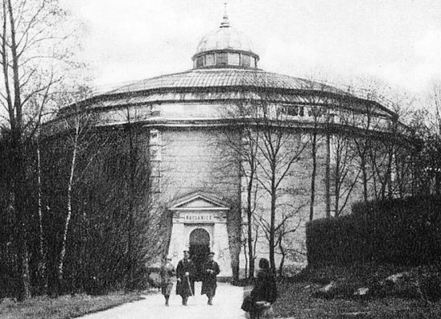
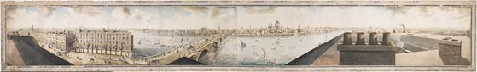
Early VR The Panorama
"In Paris I saw panoramas of Jerusalem and Athens. I recognized all the monuments immediately, every building, right down to the tiny room I stayed in in Saint-Sauveur Convent. No traveler has ever endured a rougher ordeal: how was I to know they were going to bring Jerusalem and Athens to Paris?"
-Chateau-briand

Slide 7
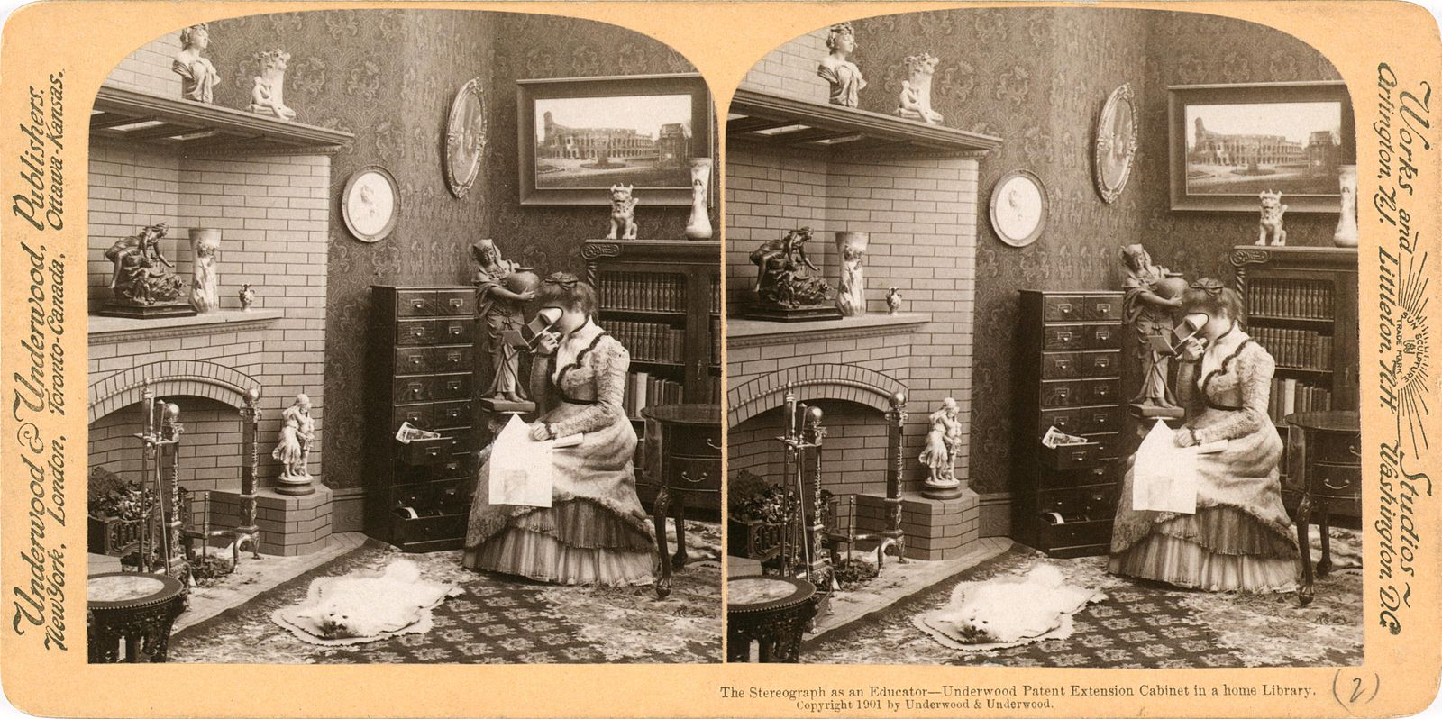
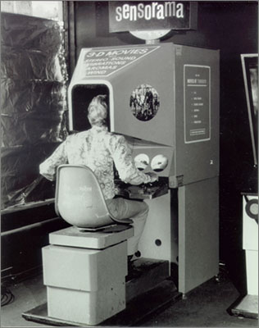
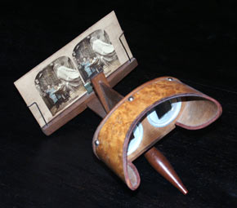
Stereoscope (1839+)
Sensorama (1962)
Morton Heilig

Slide 9
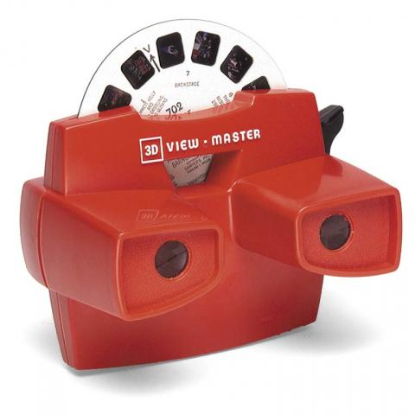
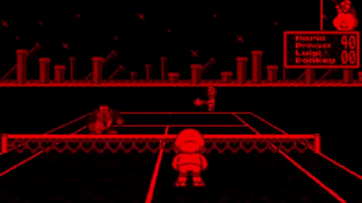

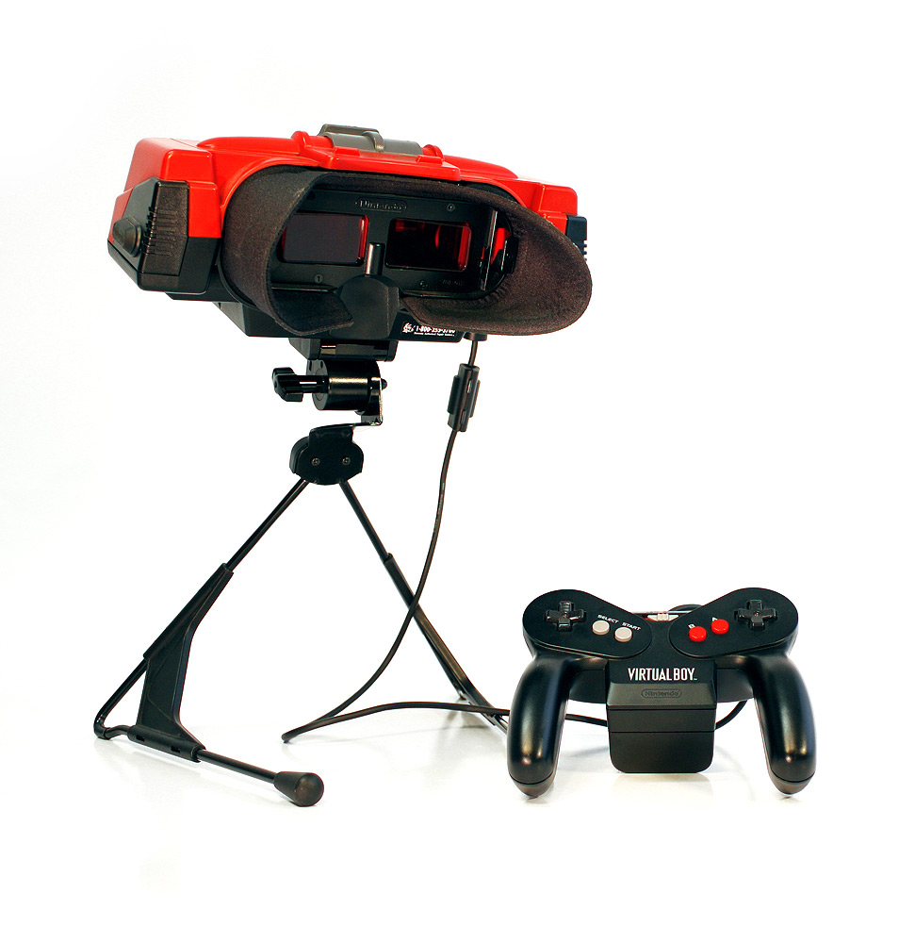
history of vr
(1995)
Viewmaster (1939)

Slide 10
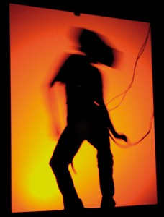
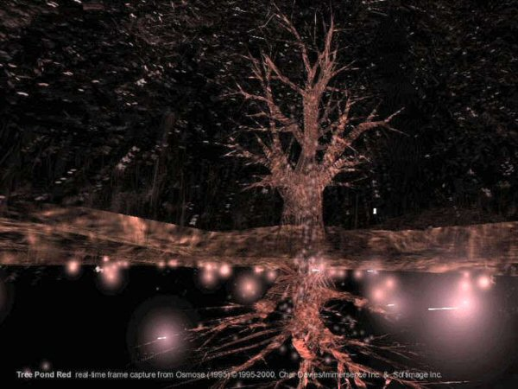
“Osmose”
Char Davies (1995)

Slide 11
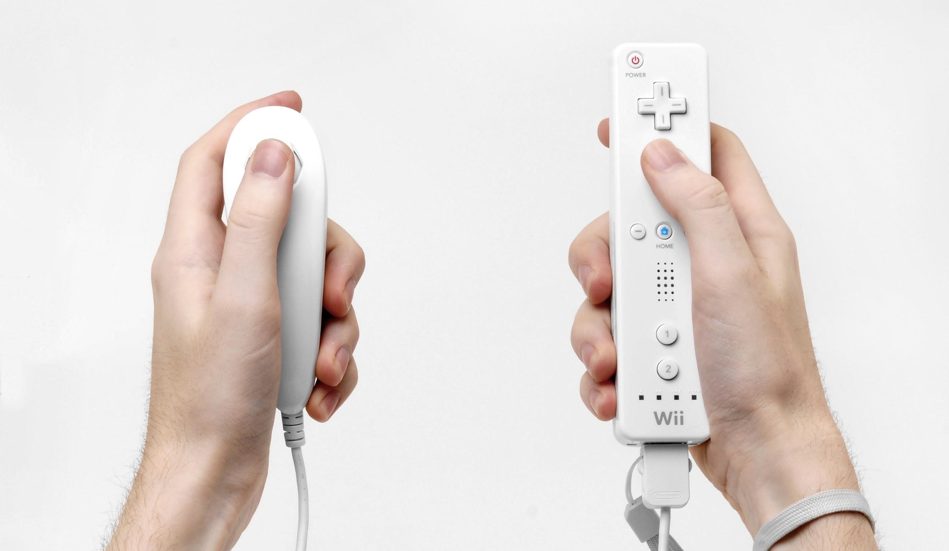
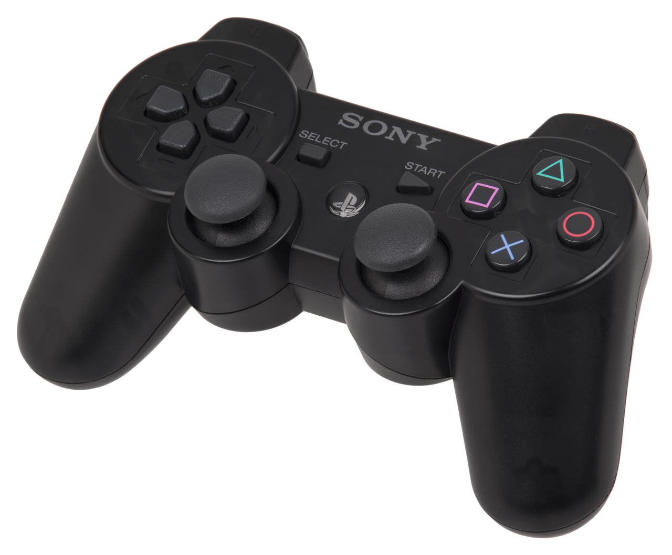
2006
Notes:
2006

Slide 12
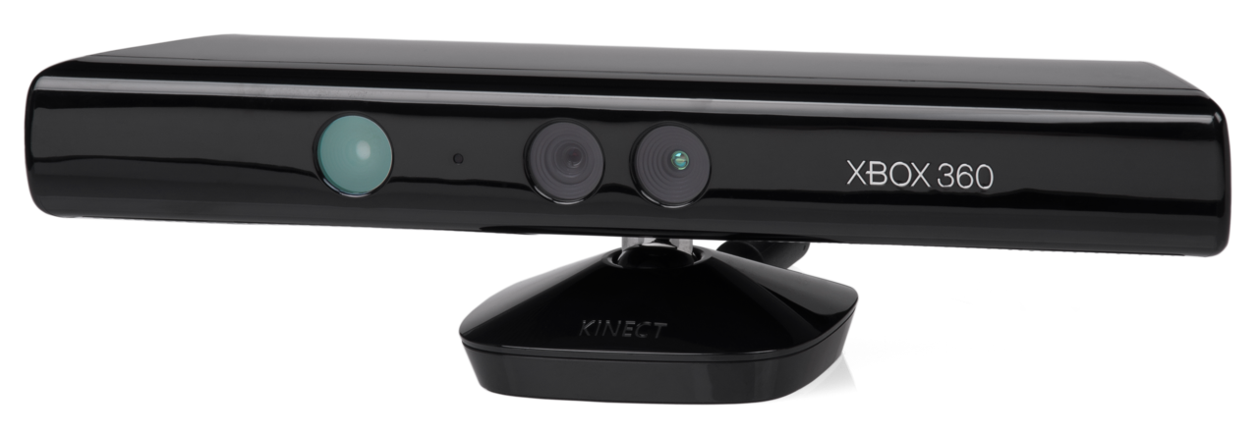
2010

Slide 13
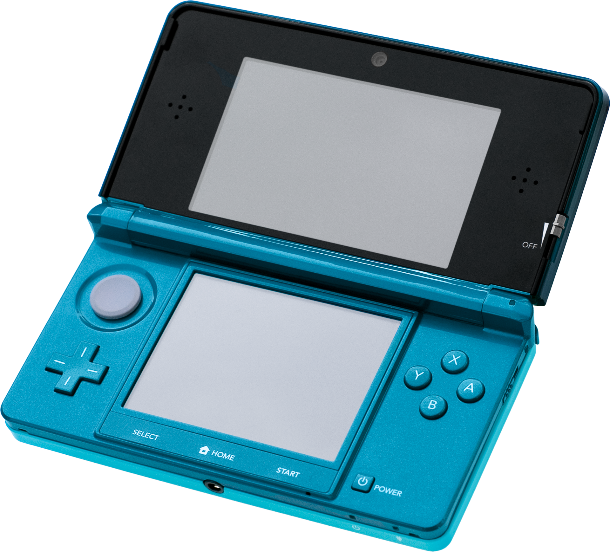
2011

Slide 14
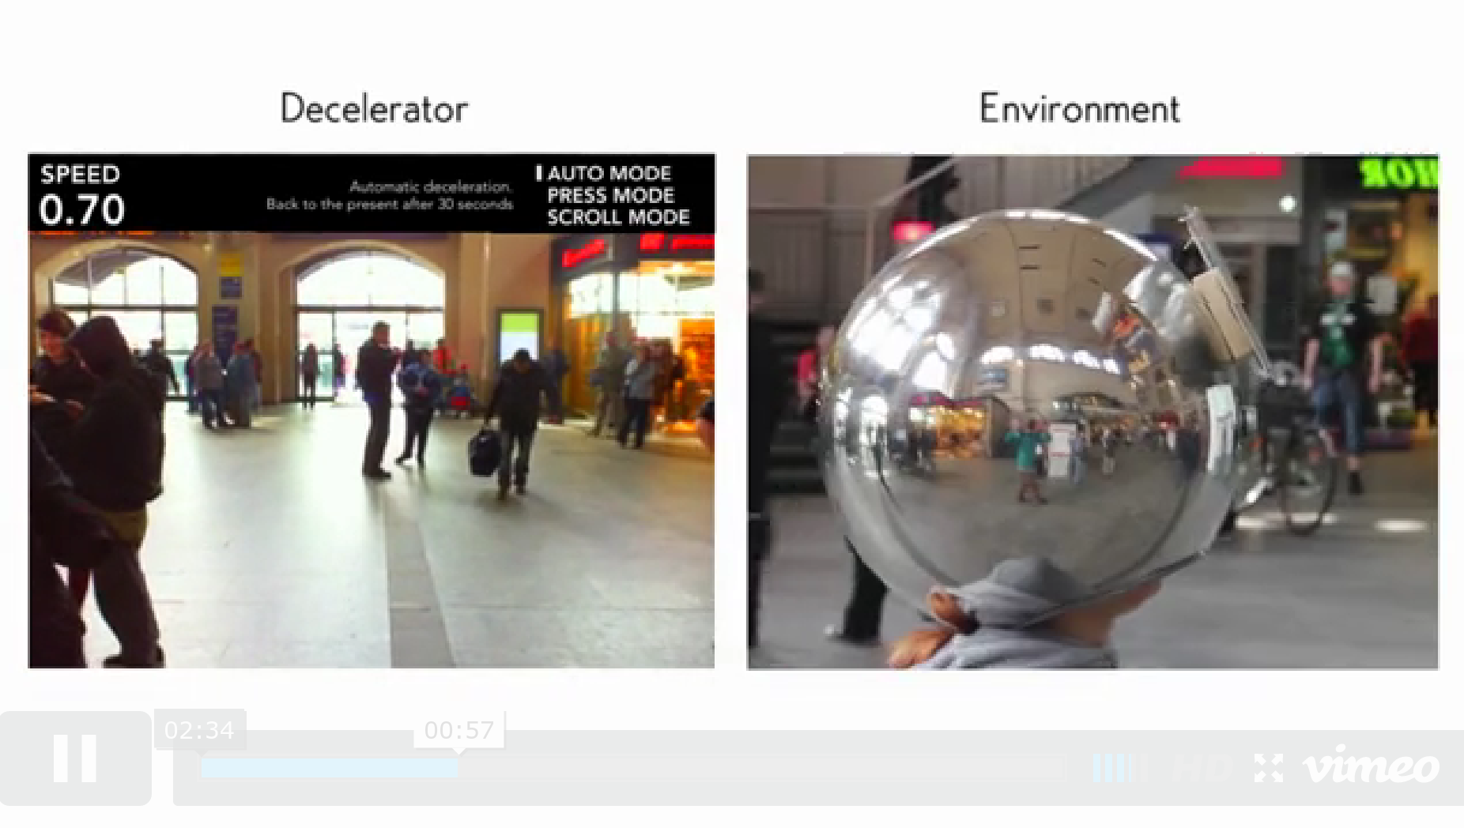

Slide 15
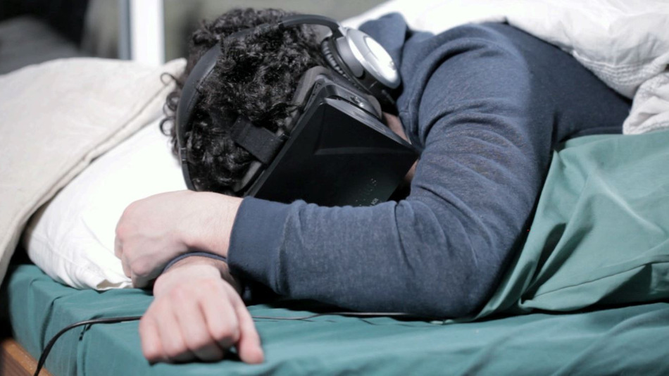
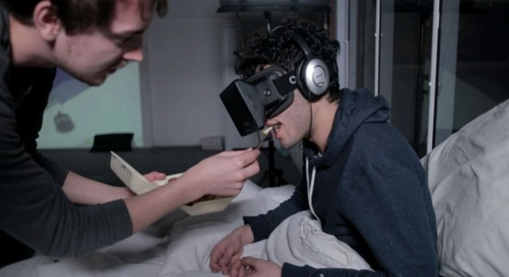
Mark Farid - Seeing I

Slide 16
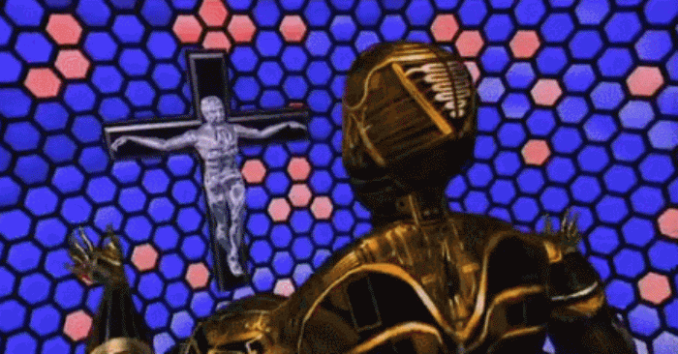

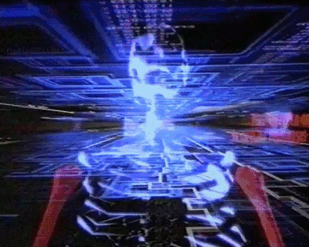

Slide 17

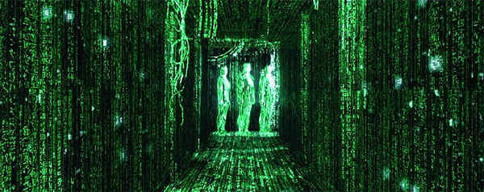
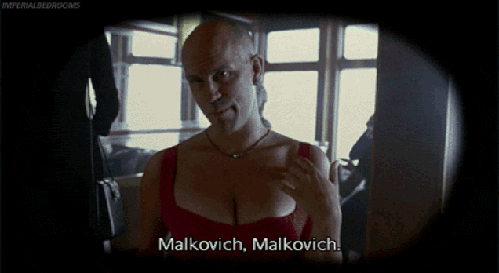

Slide 18
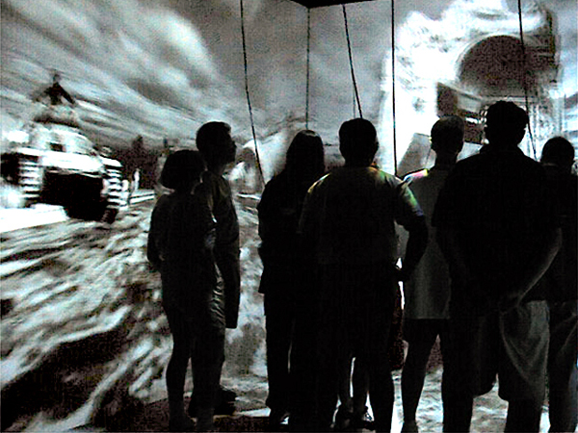
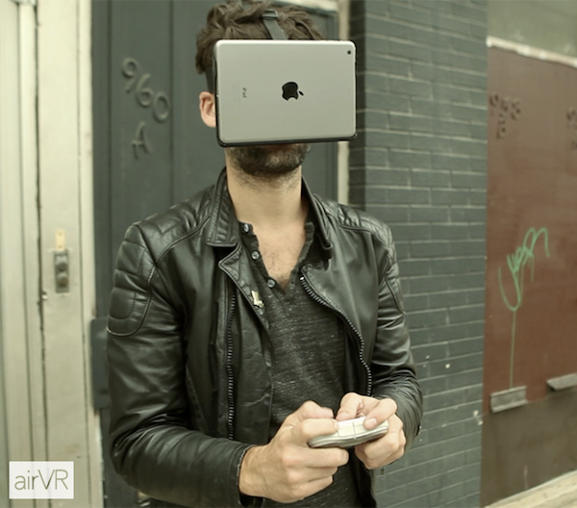
other related tech
CAVE (1990s)
AirVR (2014)

Slide 19
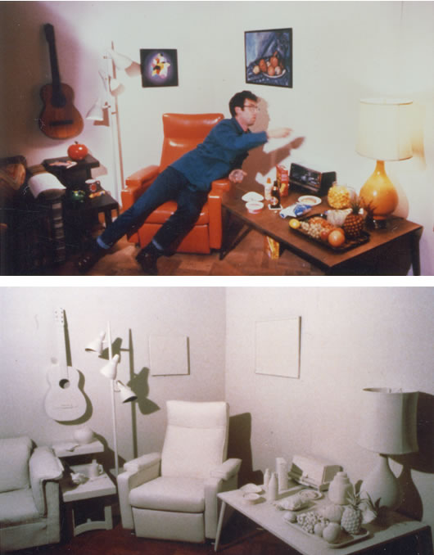
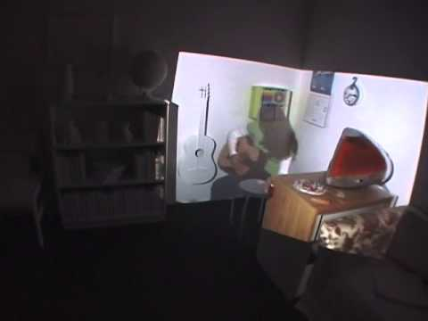
displacements
michael naimark

Slide 20
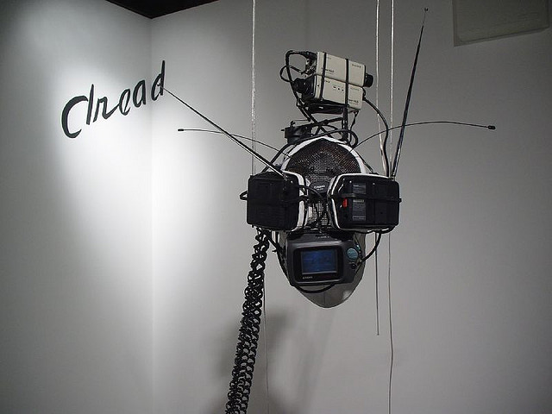
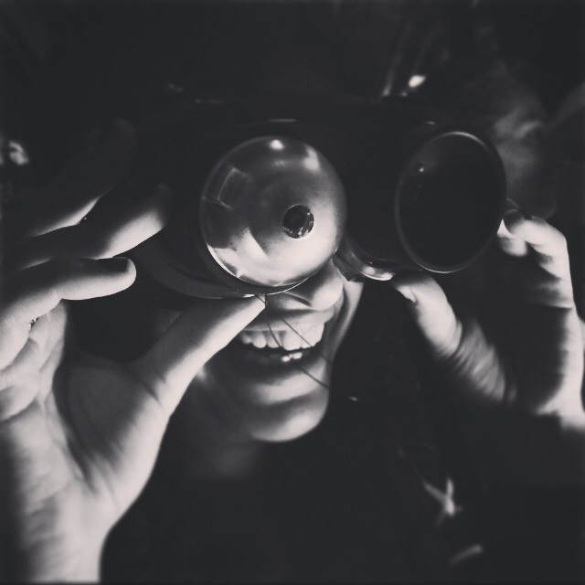
Virtual Intelligence Mask by Acconci Studios
Offline Eye by Wu Juehui

Slide 21
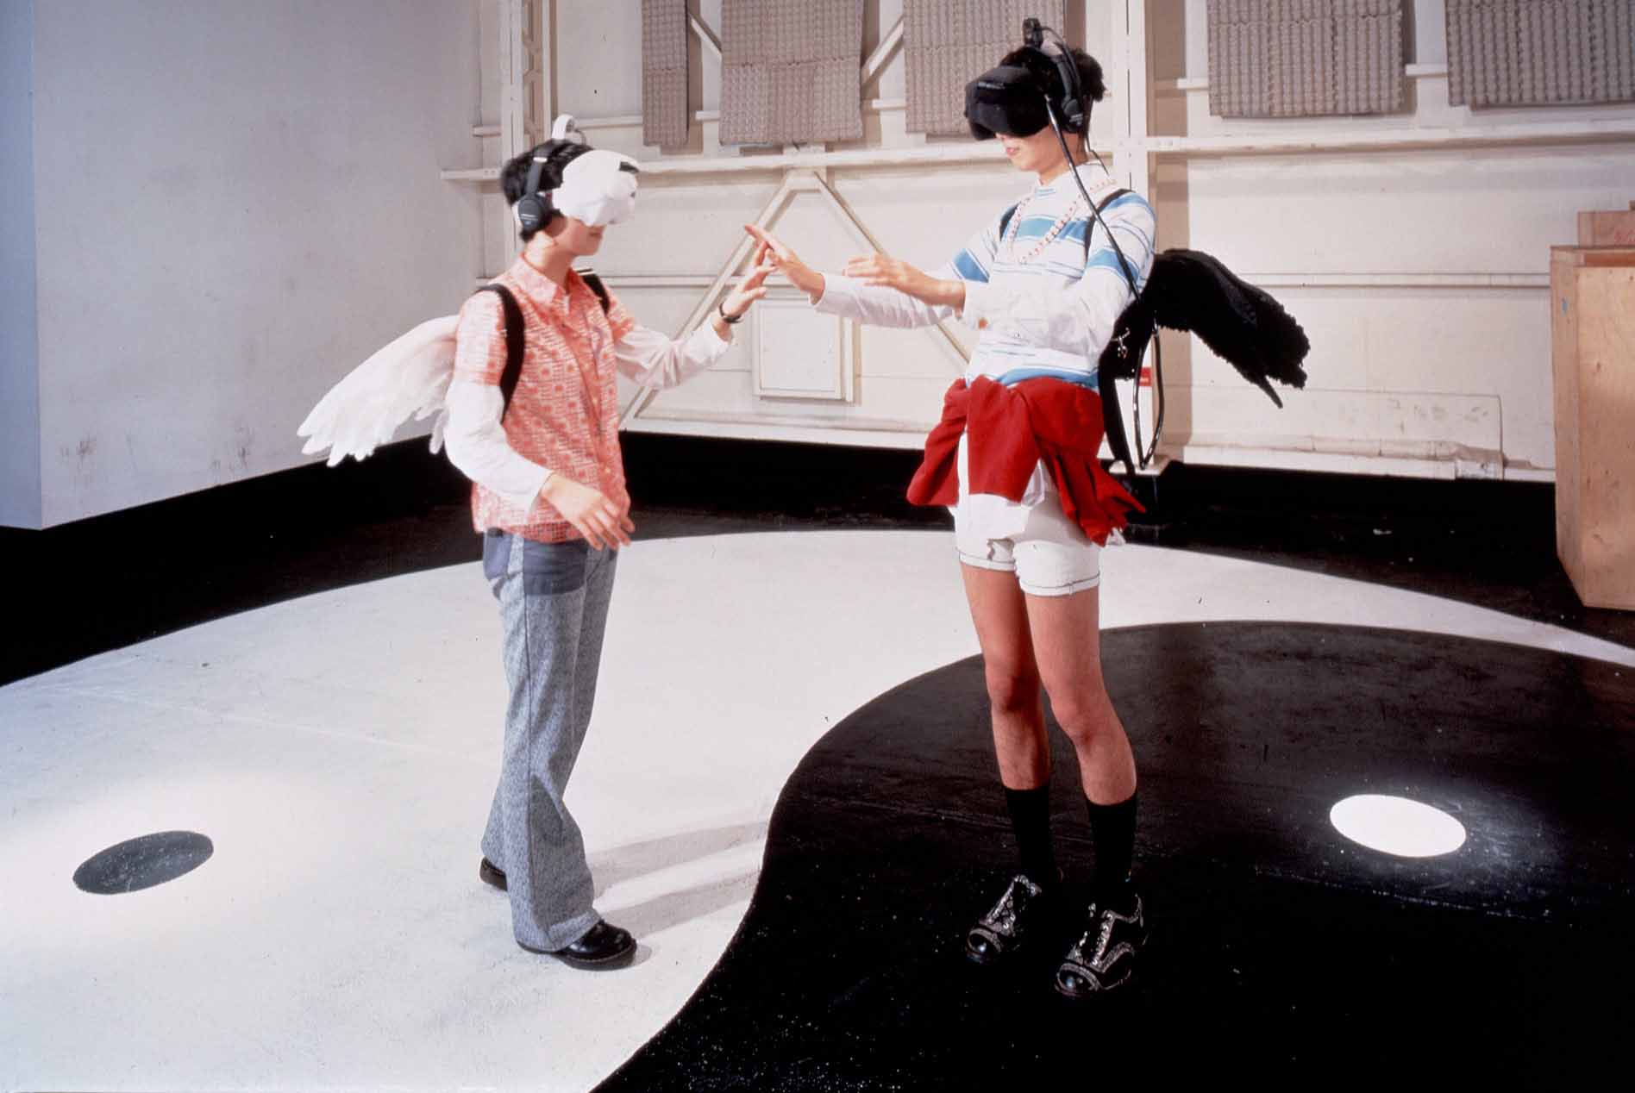
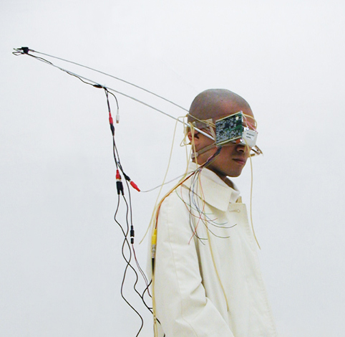
Kazuhiko Hachiya’s Inter Dis-Communication Machine
Takehito Etani’s Third Eye Project

Slide 22
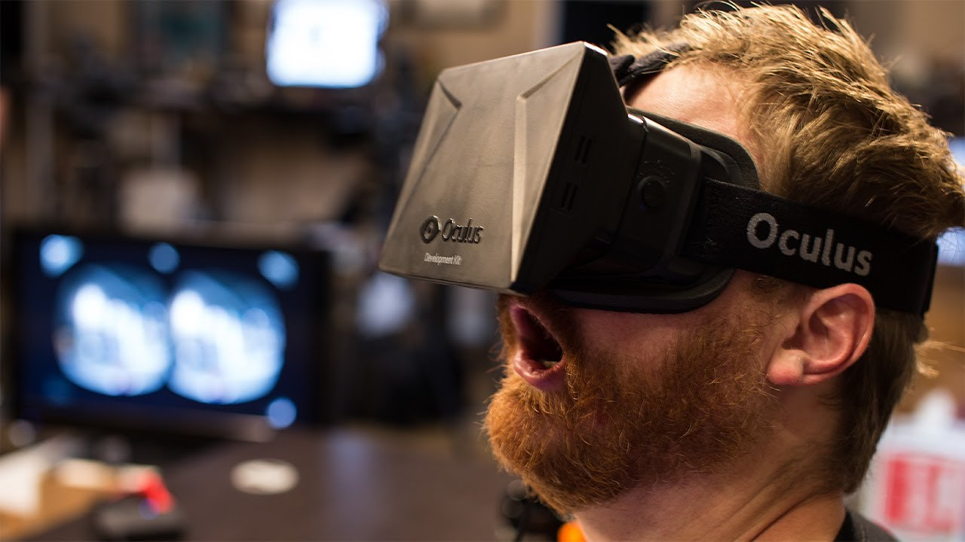

Enter Oculus
why now?
-head tracking good
-computers fast enough to make something believable

Slide 23
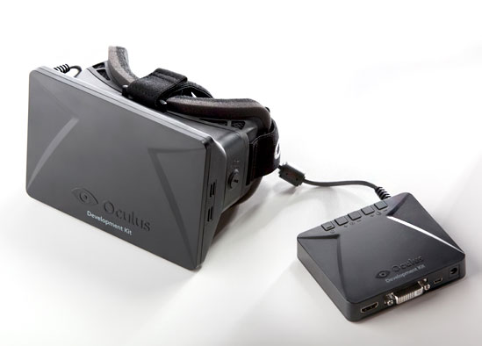
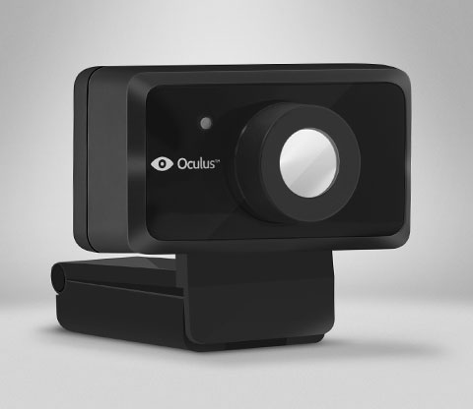
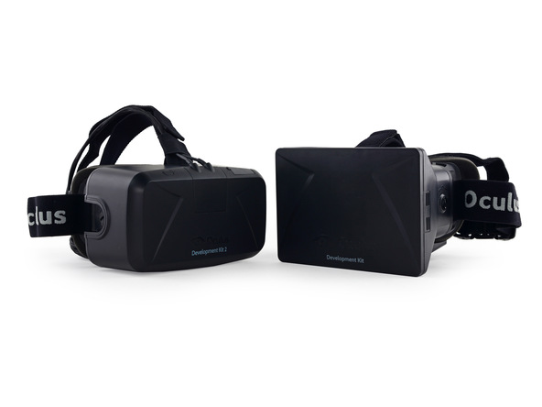
Rift
Tech
DK2: 1080p 75hz with positional tracking

Slide 24
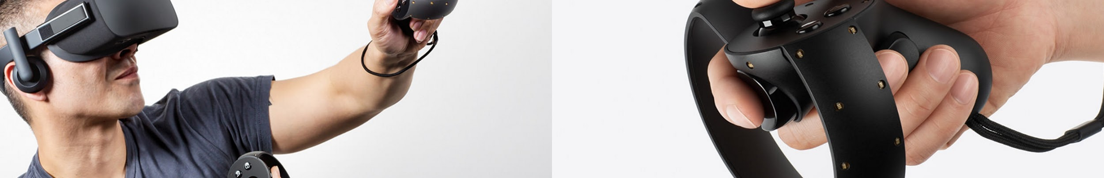
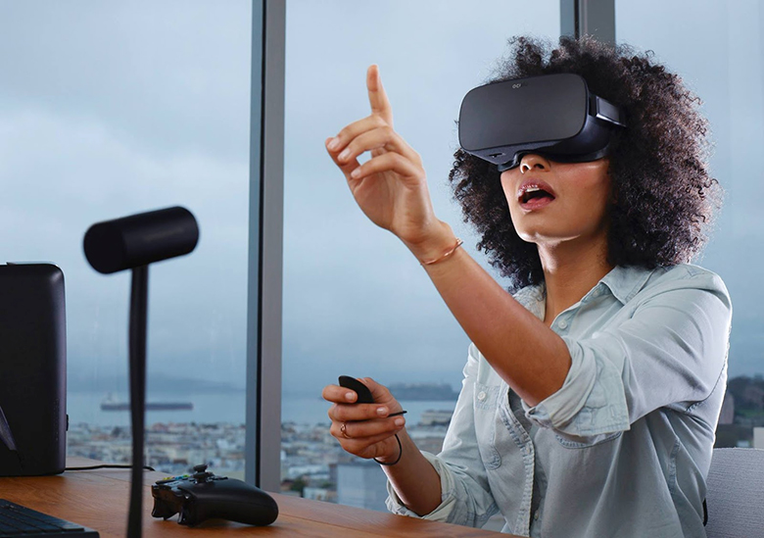
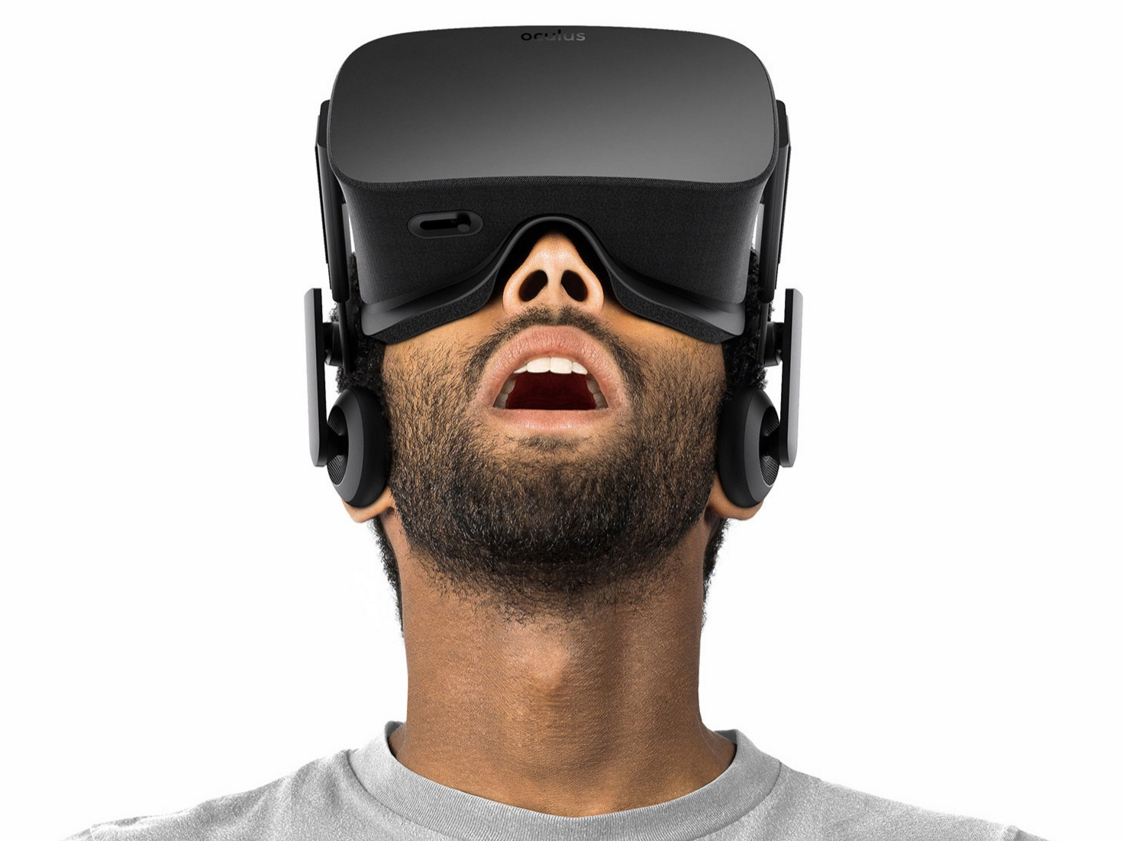

Slide 25
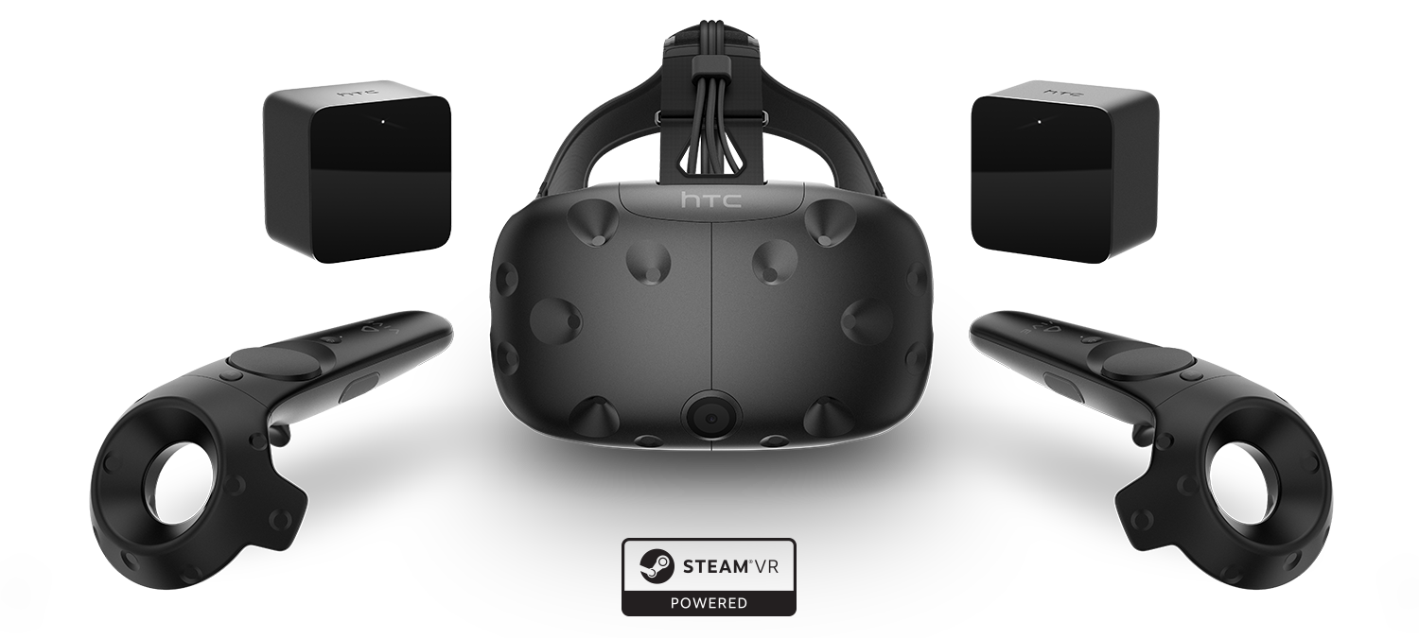
HTC Vive

Slide 26

Notes:
Nausea downside

Slide 27
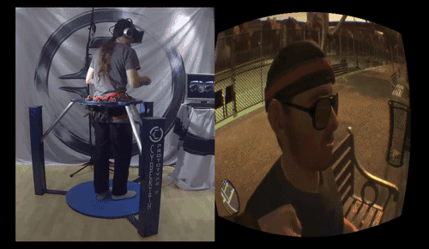
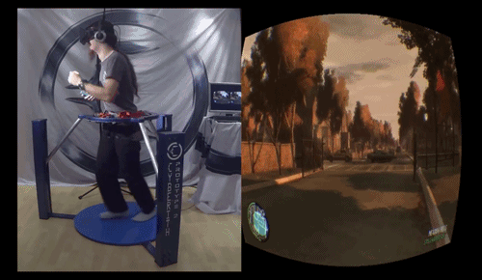



Slide 28
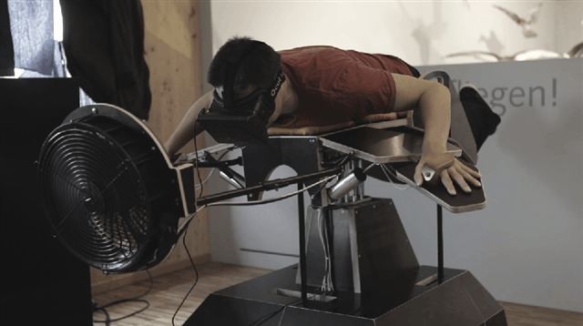

Slide 29
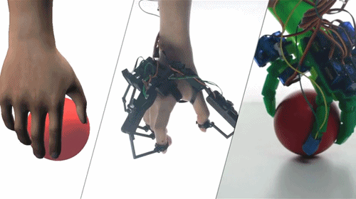
dexmo on kickstarter

Slide 30
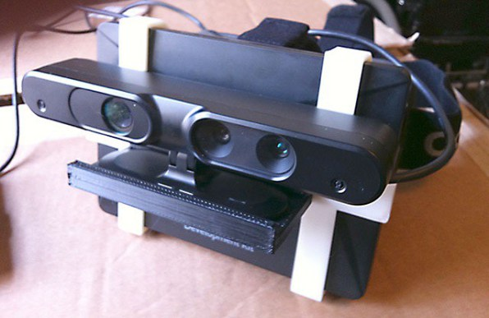
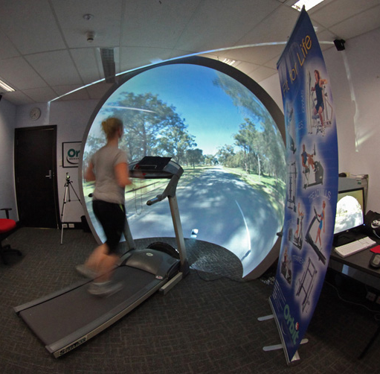
road to vr, paul bourke

Slide 31
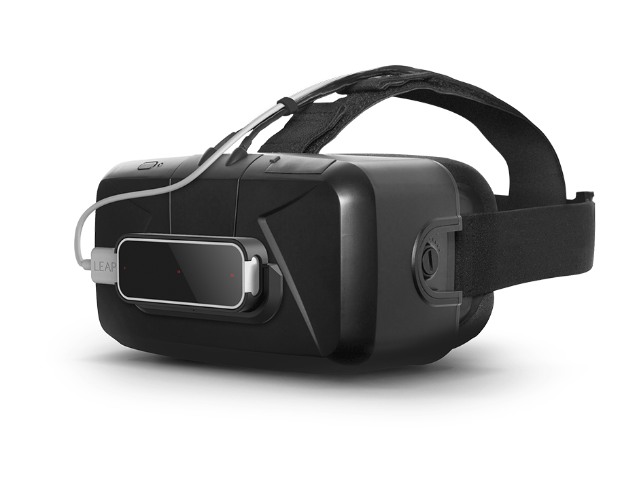
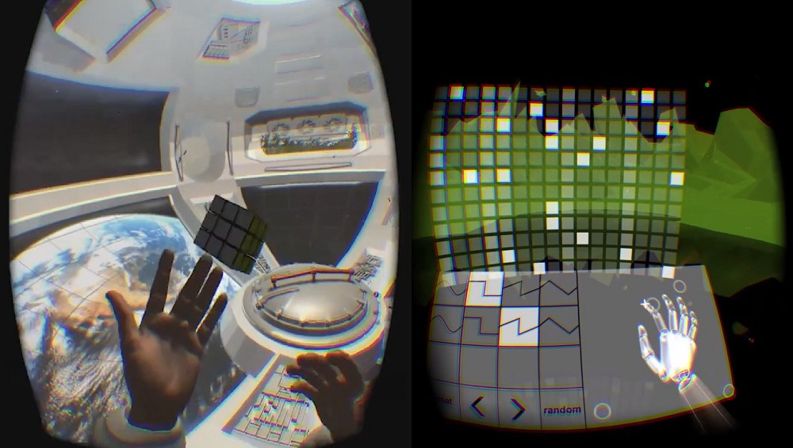
Leap Motion

Slide 32
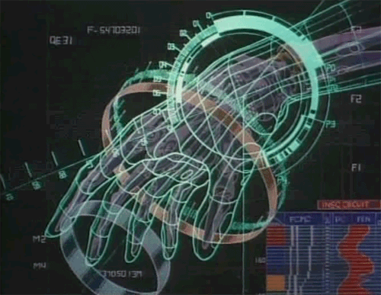
Why do we care to develop more and more immersive games and interactive applications?

Slide 33
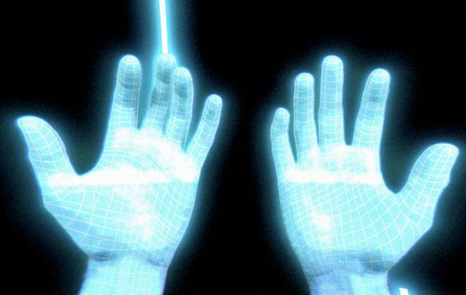
Should we be worried about the future?

Slide 34
“No one ever got drunk off the word wine.”

Slide 35
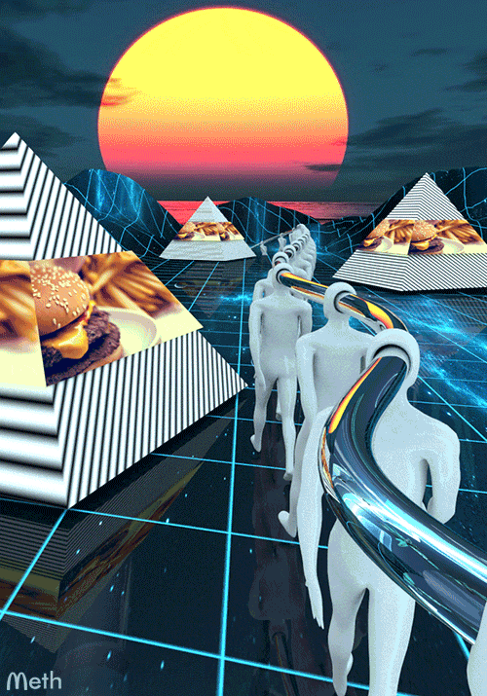
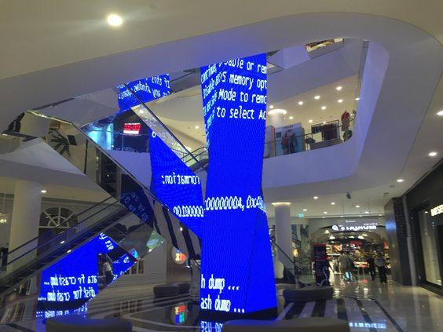
dependency

Slide 36

We are all cyborgs.
Notes:
cybernetic entities

Slide 37

“None of this was real, but cold was cold.” from William Gibson’s Neuromancer

Slide 38

confounding the image and the real
indiscernible origins
“an image without resemblance”
Notes:
epistemological skepticism fueling a distinction between perception and reality
the mind as closest thing to a source of external projections, the mind as the ultimate discernible source
as a photographer, im obsessed with imagery, images and vision
hyperreal definition
-----------------------

Slide 39


